Slide 1
Chapter-15:
Make a Connection
Upcode Software
Engineer Team
-2023-

Slide 2
CONTENT
What is Socket ?
Make a network Socket connection.
To read data from a Socket.

Slide 3
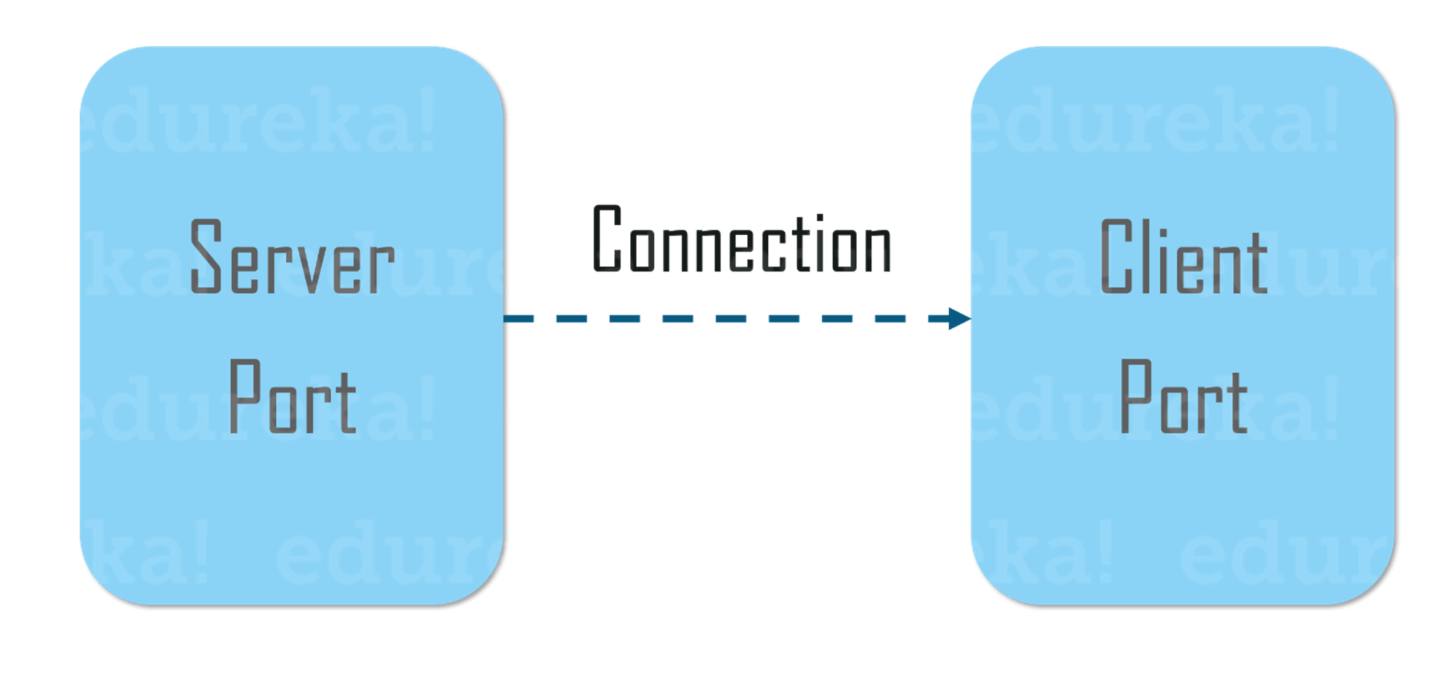
What is Socket ? (1/n)
To connect to another machine, we need a Socket connection. A Socket ( java.net.Socket class) is an object that represents a network connection between two machines. What’s a connection? A relationship between two machines, where two pieces of software know about each other

Slide 4
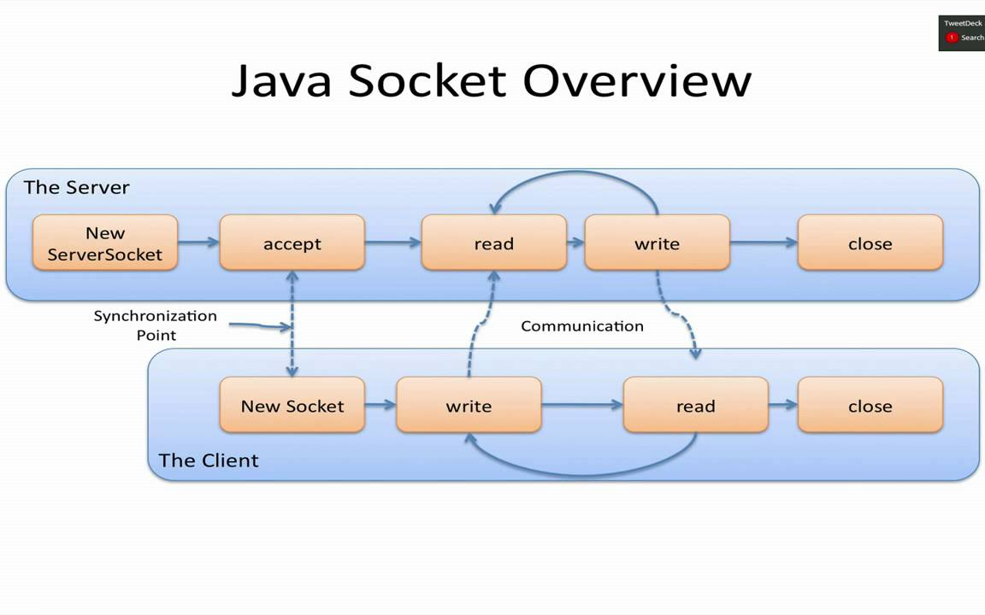
What is Socket ? (2/n)
The term socket programming refers to writing programs that execute across multiple computers in which the devices are all connected to each other using a network.
There are two communication protocols that we can use for socket programming: User Datagram Protocol (UDP) and Transfer Control Protocol (TCP).

Slide 5
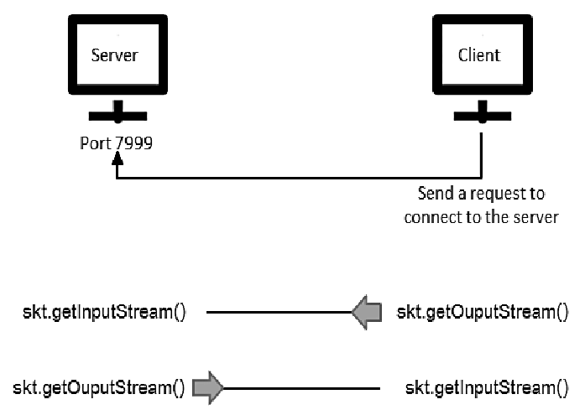
What is Socket ? (3/n)
The main difference between the two is that UDP is connection-less, meaning there’s no session between the client and the server, while TCP is connection-oriented, meaning an exclusive connection must first be established between the client and server for communication to take place.
This tutorial presents an introduction to sockets programming over TCP/IP networks, and demonstrates how to write client/server applications in Java. UDP isn’t a mainstream protocol, and as such, might not be encountered often.

Slide 6
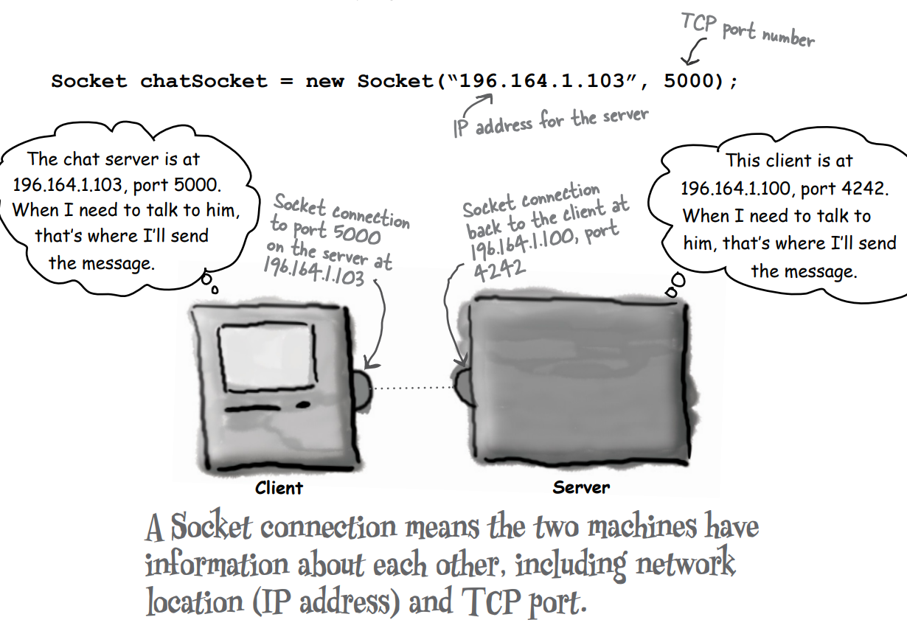
Make a network Socket connection. (1/n)
To make a Socket connection, you need to know two things about the server: who it is, and which port it’s running on. In other words, IP address and TCP port number.

Slide 7
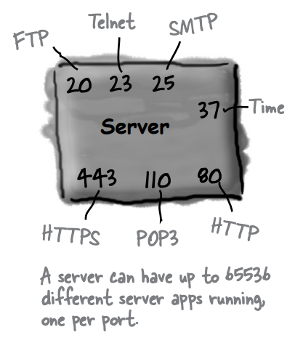
Make a network Socket connection. (2/n)
A TCP port is just a number. A 16-bit number that identifies a specific program on the server.
Well-known TCP port numbers for common server applications.
The TCP port numbers from 0 to 1023 are reserved for wellknown services. Don’t use them for your own server programs!
You have 65536 of them on a server (0 - 65535).

Slide 8
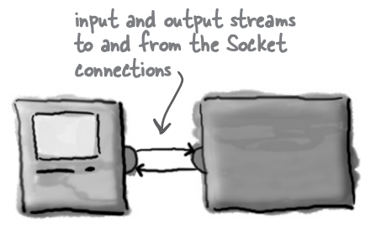
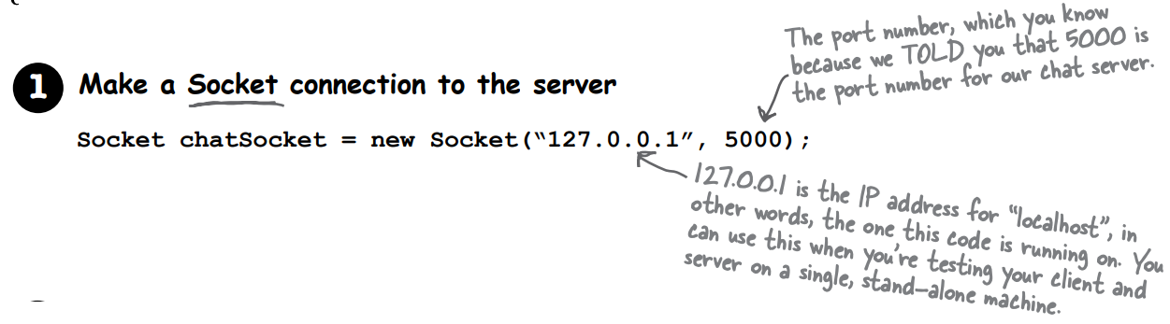
To read data from a Socket. (1/n)
To communicate over a Socket connection, you use streams.

Slide 9
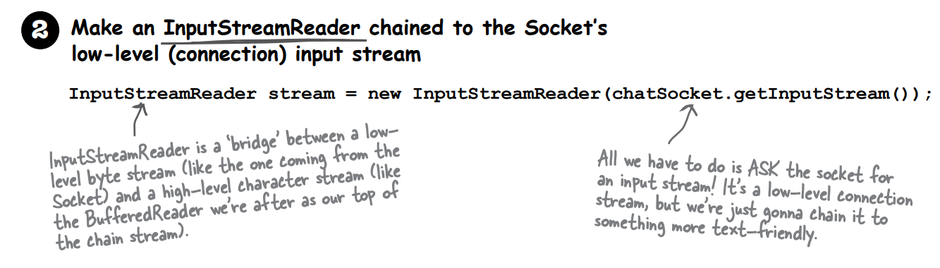
To read data from a Socket. (2/n)

Slide 10
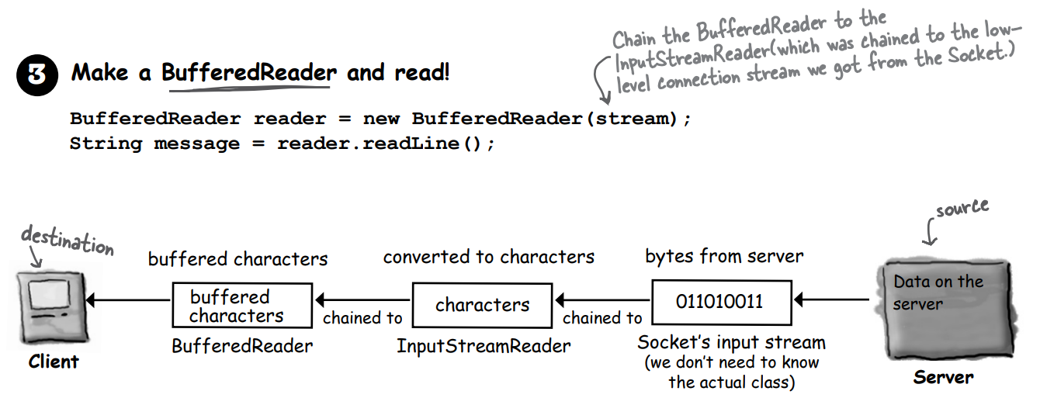
To read data from a Socket. (3/n)

Slide 11
Thank you!
Presented by Jahongir Sherjonov
(jakhongirsherjonov@gmail.com)

